Slide 1
National Cancer Patient Experience Survey
2024 communications toolkit

Slide 2
CONTENTS
About this toolkit
Communications messaging
Communications assets
Frequently asked questions

Slide 3
ABOUT THIS TOOLKIT
What is this toolkit?
This toolkit is designed to help with the communication and promotion of the 2024 National Cancer Patient Experience Survey (NCPES) during the fieldwork period (November 2024 to January 2025).
The aim of the toolkit is to raise awareness of the survey amongst patients who will be eligible to complete the 2024 survey.
All communication materials are available to download at www.ncpes.co.uk/promoting-the-survey.
Why is it important to promote the survey?
Patients who will be eligible are all adult patients (aged 16 and over), with a confirmed primary diagnosis of cancer, who have been admitted to hospital as inpatients for cancer related treatment, or who were seen as day case patients for cancer related treatment, and have been discharged during the months of April, May or June 2024.
Eligible patients will be sent letters to invite them to take part in the survey. A letter will be sent out around 15 November 2024, with two reminders shared around 6 December 2024 and 8 January 2025.
Additional promotion of the survey can help encourage people to take part if they have been invited. It is important that as many people as possible respond to the survey so that the results reflect the views of cancer patients.
How should the toolkit be used?
To reach these audiences effectively, it is likely that most communication will be carried out by NHS trusts who are providing treatment to eligible patients. This toolkit is a guide and it's understood that you will adapt the content as needed to best communicate with different audiences. Please ensure you do not change the core messaging.
We would encourage you to look at groups that are underrepresented in your results locally and try to target communications accordingly.
Notes:
For those aged 16 and under, feedback is collected via the Under 16 Cancer Patient Experience Survey.
The National Cancer Patient Experience Survey is a separate survey from the Cancer Quality of Life Survey.

Slide 4
Communications messaging

Slide 5
ABOUT THE NCPES
This summary can be used to describe the National Cancer Patient Experience Survey and its purpose. Below is a short and longer version depending on the content / channel you are applying it to.
Short summary
At the NHS, we want our patients to have the best experience possible and having continuous patient feedback is crucial in helping us to deliver what patients want and need. The National Cancer Patient Experience Survey (NCPES) asks for feedback from cancer patients (16 years and over), to inform and improve local cancer services across England. Those who are treated for cancer as an inpatient or day-case, and left hospital in April, May or June 2024, will be invited to take part in the survey. For more information on the survey, please visit www.ncpes.co.uk.
Longer summary
At the NHS, we want our patients to have the best experience possible and having continuous patient feedback is crucial in helping us to deliver what patients want and need.
The National Cancer Patient Experience Survey (NCPES) asks for feedback from cancer patients (16 years and over), to inform and improve local cancer services across England. Those who were treated for cancer as an inpatient or day-case, and left hospital in April, May or June 2024, will be invited to take part in the survey.
The NHS and cancer charities use the results to understand what is working well and which areas need improvement. The results enable them to identify national and local priorities and work with patients and partners to deliver change. The 2024 CPES fieldwork will begin in mid-November 2024, with results available next year. For more information on the survey, please visit www.ncpes.co.uk.

Slide 6
KEY MESSAGES
Primary key message:
Understanding the experiences of care and treatment is extremely important to the NHS.
The National Cancer Patient Experience Survey (NCPES) is designed to help improve the experience and quality of care for adults (16 years and over) being treated for cancer.
You may receive other surveys about your experiences of cancer, but we would really appreciate you completing the NCPES to inform positive change and continuous improvement of NHS cancer services.
If you are invited, please don’t miss your opportunity to take part and make your voice heard. We need as many people as possible to respond to the invite so that the results reflect the views of different cancer patients.
Secondary key messages:
The National Cancer Patient Experience Survey (NCPES) asks for feedback from cancer patients to monitor cancer services nationally and to inform improvements to local cancer services across England.
The NHS and cancer charities use the NCPES results to understand what is working well and which areas need improvement. The results enable them to identify national and local priorities and work with patients and partners to deliver service changes.

Slide 7
WEBSITE COPY
Please consider using the following web copy on your website alongside the web banner which can be downloaded here.
​Title – National Cancer Patient Experience Survey​
Copy – At the NHS, we want our patients to have the best experience possible and having continuous patient feedback is crucial in helping us deliver what patients want and need. ​
​The National Cancer Patient Experience Survey (NCPES) asks for feedback from cancer patients (16 years and over), to inform and improve local cancer services across England. Those who were treated for cancer as an inpatient or day-case, and left hospital in April, May or June 2024, will be invited to take part in the survey. ​If you are invited, you will receive a letter with information about the survey. Please don’t miss the opportunity to take part and share your experiences of care. You may receive other surveys about your experiences of cancer, but we would really appreciate you completing the NCPES to inform positive change and continuous improvement of NHS cancer services.
​The survey takes no more than 20 minutes to complete and can be done online, on paper, or over the phone. If you need support completing the survey or need it made available in another language, you can call the free helpline number: 0800 103 2804. ​
The NHS and cancer charities use the results to understand what is working well and which areas need improvement. The results enable them to identify national and local priorities and work with patients and partners to deliver change.​
​The survey is anonymous, and all personal data will be kept safe.​
​The results of the survey will be available in Summer 2025. ​
​For more information on the survey and how to access help and support in completing it, please visit www.ncpes.co.uk. ​

Slide 8
NEWSLETTER COPY
Newsletter copy can be used in public facing newsletters or shared with partner organisations that have agreed to help raise awareness of the survey.
NHS organisation:
Cancer Patient Experience Survey 2024
We have launched our National Cancer Patient Experience Survey (NCPES), asking for feedback from cancer patients (16 years and over*), to inform and improve local cancer services across England.
We want our patients to have the best experience possible and hearing about your experience is crucial in helping us deliver what you need and want.
The NHS and cancer charities use the results to understand what is working well and which areas need improvement. The results enable them to identify national and local priorities and work with patients and partners to deliver improvements.
Those who were treated for cancer as an inpatient or day-case, and left hospital in April, May or June 2024, will be invited to take part in the survey. If you receive an invitation, please fill out the questionnaire and have your say so we can deliver the best possible service to patients. If you need support completing the survey or need it made available in another language, you can call the free helpline number 0800 103 2804.
For more information about the survey and other ways to provide feedback on cancer care please visit www.ncpes.co.uk.
Non-NHS organisation:
Cancer Patient Experience Survey 2024
NHS England has launched its National Cancer Patient Experience Survey (NCPES), asking for feedback from cancer patients (16 years and over*), to inform and improve local cancer services across England.
The NHS want patients to have the best experience possible and hearing about your experience is crucial in helping them to deliver what you need and want.
The NHS and cancer charities use the results to understand what is working well and which areas need improvement. The results enable them to identify national and local priorities and work with patients and partners to deliver improvements.
Those who were treated for cancer as an inpatient or day-case, and left hospital in April, May or June 2024, will be invited to take part in the survey. If you receive an invitation, please fill out the questionnaire and have your say so we can deliver the best possible service to patients. If you need support completing the survey or need it made available in another language, you can call the free helpline number 0800 103 2804.
For more information about the survey and other ways to provide feedback on cancer care please visit www.ncpes.co.uk.

Slide 9
BLOG COPY
This blog has been developed for use on webpages and can be adapted for your local audience with inclusion of local case studies. If using the patient case study we’ve provided, please leave their wording unchanged.
At the NHS we want our patients to have the best experience possible and having continuous patient feedback is crucial in helping us deliver what patients want and need.
The National Cancer Patient Experience Survey (NCPES) asks for feedback from cancer patients (16 years and over*), to inform and improve local cancer services across England. Those who were treated for cancer as an inpatient or day-case, and left hospital in April, May or June 2024, will be invited to take part in the survey. If you are invited, you will receive a letter with information about the survey. Please don’t miss the opportunity to take part and share your experiences of care.
The NHS and cancer charities use the results to understand what is working well and which areas need improvement. The results enable them to identify national and local priorities and work with patients and partners to deliver change.
If you are invited to take part, please fill out the questionnaire and have your say. Every response helps us to deliver the best possible service to patients. You may receive other surveys about your experiences of cancer, but we would really appreciate you completing the NCPES to inform positive change and continuous improvement of NHS cancer services.
If you need support completing the survey or need it made available in another language, you can call the helpline number for free: 0800 103 2804.
For more information on the survey please visit www.ncpes.co.uk.
“NCPES gives us a chance to comment on the NHS service, to give praise where it is due, and to identify where things are not quite as we would wish. NCPES is the tool that thousands of patients every year have used to improve our NHS and to improve care for the patients of the future, and the responses provide vast amounts of evidence for researchers looking for evidence as to what works best – for us, the patients.
I’ve been able to help shape the survey, and I have seen how influential it can be, most obviously in shaping national policy. Since the Cancer Strategy of 2015, the NHS has been tasked with regarding Patient Experience as being just as important as clinical outcomes, and much of the evidence for that change came from NCPES findings. Patients said loudly and clearly that what mattered was not just the cancer pathway and where that ended up, but the quality of our experience along our journey.”
Richard Stephens, patient representative on the NCPES Advisory Group

Slide 10
SOCIAL MEDIA COPY
Over the following pages you will find suggested copy for:
X (formerly Twitter)
Facebook
Instagram stories
Instagram post
Alongside the wording provided, you can share assets provided in this toolkit, for example:
Social media cards
Infographics
Latest results
Case study video
Please always tag @NHSEngland and when relevant for the channel use the hashtag #CancerPatientExperienceSurvey.

Slide 11
X (FORMERLY TWITTER)
Posts for the beginning of the fieldwork period (November 2024):
At the NHS we want our patients to have the best experience possible and having continuous patient feedback is crucial in helping us deliver what patients want and need. If invited, have your say in the #CancerPatientExperienceSurvey 📢 www.ncpes.co.uk @NHSEngland
Understanding our patients’ experiences of care and treatment is extremely important to us as it helps us adapt our services to best suit your needs. If invited, have your say in the #CancerPatientExperienceSurvey 📢 www.ncpes.co.uk @NHSEngland
To provide the best possible care for people diagnosed with cancer, it’s important for us to listen & learn from their experiences. The #CancerPatientExperienceSurvey informs how local cancer services are improved 🤝. If invited, have your say www.ncpes.co.uk @NHSEngland
Understanding the experiences of patients is essential for us to provide high quality personalised care and treatment. If you are invited to take part in the #CancerPatientExperienceSurvey, have your say 📢 www.ncpes.co.uk @NHSEngland
Posts to remind people to take part at the end of the fieldwork period (January 2025):
Don’t miss your chance to help inform positive change to cancer services 🤝. If invited, have your say in the #CancerPatientExperienceSurvey www.ncpes.co.uk @NHSEngland
Final reminder ⏰ help contribute to future improvements in your local cancer services. If you are invited to take part in the #CancerPatientExperienceSurvey, have your say www.ncpes.co.uk @NHSEngland

Slide 12
FACEBOOK
Posts for the beginning of the fieldwork period (November 2024):
We want to provide the best experience possible to cancer patients and having continuous feedback is crucial in helping us deliver what our patients want and need.
If you are invited to take part in the National Cancer Patient Experience Survey, please have your say 📢 and help contribute to future improvements in your local cancer services.
The survey will be posted to those eligible to complete. For more information on the survey and how to access help and support in completing it please visit www.ncpes.co.uk
---
Understanding our patients' experiences of care and treatment is extremely important to us as it helps us adapt our services to best suit their needs. If invited, please take part in the National Cancer Patient Experience Survey and help shape NHS services for future patients 🤝.
The survey will be posted to those eligible to complete. For more information on the survey and how to access help and support in completing it please visit www.ncpes.co.uk
Posts to remind people to take part at the end of the fieldwork period (January 2025):
Don’t miss your chance to help inform positive change to cancer services. The National Cancer Patient Experience Survey was sent out to those who are eligible, and will be closing soon ⏰.
​If you were invited, please don’t miss the opportunity to take part and share your experiences of care. ​The NHS and cancer charities use the results to understand what is working well and which areas need improvement.
The survey has been posted to those eligible to complete. For more information on the survey and how to access help and support in completing it, please visit www.ncpes.co.uk

Slide 13
INSTAGRAM
Instagram stories (use images with text overlaid)
Story one - Were you treated for cancer in April, May or June 2024? (if possible include swipe up link to www.ncpes.co.uk/faq)
Story two - Did something or someone really support you through your treatment, or is there something you wish you were offered looking back on your experience? (if possible include swipe up link to www.ncpes.co.uk/faq)
Story three - The #CancerPatientExperienceSurvey helps to inform improvements in local cancer services and outcomes for people affected by cancer. (if possible include swipe up link to www.ncpes.co.uk/faq)
Story four - If you’re invited to take part, please have your say and help contribute to future improvements in your local cancer services. Click the link for more information. (if possible include swipe up link to www.ncpes.co.uk/faq)
Instagram post
Were you treated for cancer in April, May or June 2024? Is there something you think the NHS should continue doing or improve on? If you’re invited to take part in the #CancerPatientExperienceSurvey please have your say and help contribute to future improvements in your local cancer services.
Understanding our patients' experiences of care and treatment is extremely important to us as it helps us adapt our services to best suit our patients' needs.
The survey will be posted to those who are eligible to take part. Visit the NCPES website (link in bio) for more information.

Slide 14
Communications assets

Slide 15
SOCIAL MEDIA CARDS
These social media cards can be shared alongside social media posts. Social media cards can be downloaded here.

Slide 16
POSTERS
Please consider displaying these posters in areas that are visible to people affected by cancer and their friends or family. You can also display them online, for example on your website, social media or TV screens in waiting areas. Posters can be downloaded here.

Slide 17
INFOGRAPHICS
These infographics are designed to explain the purpose and process of NCPES. The files can be downloaded from here.

Slide 18
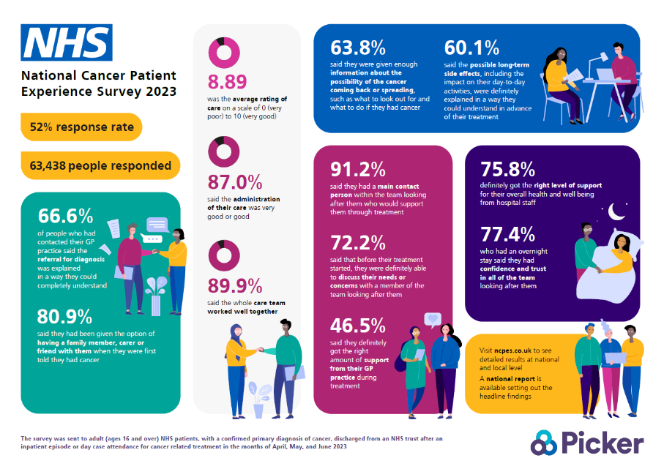
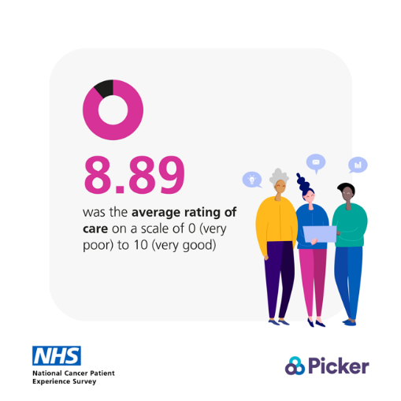
LATEST RESULTS
There are national results infographic and social cards that show a summary of the 2023 results and an infographic template is available for you to add your local results, which can be used to encourage patients to complete this year’s survey. The files can be downloaded here.
Results infographic:
Example of social card:

Slide 19
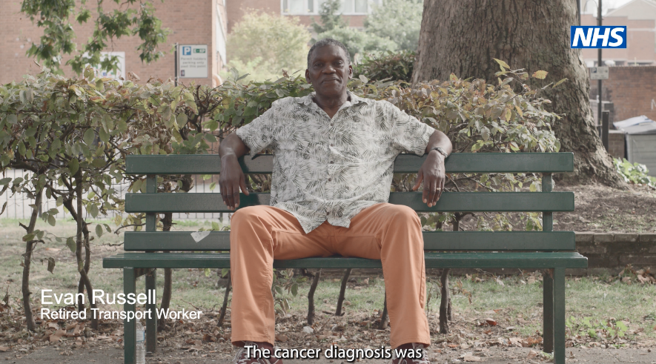
CASE STUDY VIDEO
National Cancer Patient Experience Survey - Improving Support for Black Men with Prostate Cancer
Guy’s and St Thomas’ NHS Foundation Trust and South East London Cancer Alliance have carried out an improvement project based on the results of the National Cancer Patient Experience Survey (NCPES) which has identified needs for improved support for black men with prostate cancer.
We have created this video to support the uptake of the NCPES survey and to encourage patients who are often underrepresented in NCPES to take part.
The aims of the case study videos are to:
Demonstrate the impact of the NCPES and how the results are used to make improvements to cancer services.
Encourage seldom heard groups to complete the NCPES.
The full version of the video is on YouTube and is available here.
Social media video clips are available here.

Slide 20
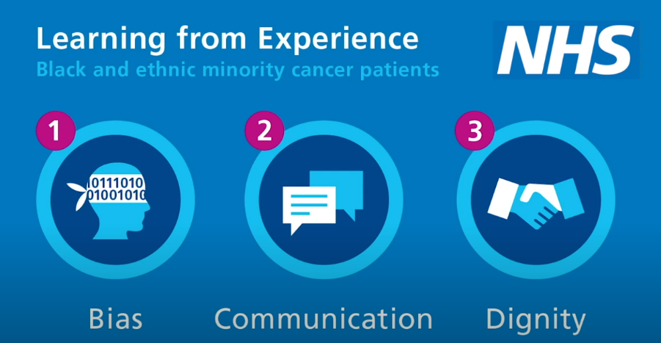
VIDEOS
Learning from experience – black and ethnic minority cancer patients
Three short films were developed by NHS England, in response to data from the NCPES, which showed ethnically diverse patients consistently report a poorer experience than white British people who take part in the survey.
The films examine three themes – bias, communication and dignity. They highlight the importance of involving and listening to people from different communities within the NCPES.
Learning from the experience of BME cancer patients – Bias
Learning from the experience of BME cancer patients – Communication
Learning from the experience of BME cancer patients – Dignity

Slide 21
IMPACT OF THE SURVEY
NCPES results are used as part of the Cancer Experience of Care Improvement Collaborative (CIC). The CIC brings together groups of cancer healthcare professionals and people with lived experience from different organisations to improve services.
The aim of the CIC is for each project team to use insight and feedback (like trust level National Cancer Patient Experience Survey results) to improve the experience of care for cancer patients and their friends and family who may provide unpaid care and support. Project teams are able to make improvements based on what matters to people who use cancer services that align with local, regional, and national priorities.
Further information on the Cancer Experience of Care Improvement Collaborative can be found here.
The videos on the page which can be used to promote the impact of NCPES and why Project Teams have got involved in the CIC.

Slide 22
Frequently Asked Questions

Slide 23
FAQs
Q. What is the purpose of the survey?
A. The purpose of collecting and analysing data via this survey is to:
To measure continuous improvement and enable local systems to assess their performance improvement with other providers and commissioners.
Provide NHS England with an up-to-date overview of cancer patient experience across England.
The survey results are used to understand patient experience and to improve cancer services across England. The results will be looked at to understand differences in people’s experiences, for example, to see if people answer differently depending on their ethnic group or their type of cancer. This will help to identify where improvements are most needed and for which groups, communities, or populations.
Q. Who is running the survey?
A. Picker Institute Europe is carrying out the survey on behalf of NHS England. For more information on Picker, visit www.picker.org.
Q. How can I find out more about the survey?
A. You can find more information about the survey, including previous survey results, at www.ncpes.co.uk.
Q. When will survey results be available?
A. Reports will be available in Summer 2025 at www.ncpes.co.uk.
Q. Who will be included in the survey?
A. The survey will cover all acute and specialist NHS Trusts in England that provide adult acute cancer services. The survey will include all adult patients (aged 16 and over), with a primary diagnosis of cancer, who have been admitted to hospital as inpatients for cancer related treatment, or who were seen as day case patients for cancer related treatment and have been discharged between 1 April 2024 and 30 June 2024.

Slide 24
FAQs
Q. I have received a questionnaire but need help completing it
A. There is a freephone helpline number: 0800 103 2804 for the survey where you can get help completing it or to request translation services to complete the questionnaire. Information is also available on the back of the cover letter that was sent to you with the questionnaire, and online at www.ncpes.co.uk/faq/
Q. Why can’t I (patient) take part in the survey?
A. The survey is only offered to adult patients (aged 16 and over) with a confirmed diagnosis of cancer who have been admitted to hospital as inpatients for cancer related treatment, or who were seen as day case patient for cancer related treatment and have been discharged between the months of April, May or June 2024.
Patients aged 16 and under will be invited to take part in the Under 16 Cancer Patient Experience Survey, please visit www.under16cancerexperiencesurvey.co.uk
Q. Do I have to take part?
A. No, if you do not want to take part, please return the blank questionnaire. You do not need to use a stamp. If you prefer, please email Picker (cpes24@picker.org) or call the helpline number (0800 103 2804) and Picker will remove you from the current survey mailing list.
Q. Should I take part if I have previously completed a survey?
A. Yes, you can still take part in this survey. There may be other surveys which ask about the experiences of cancer patients, but we would be grateful to hear your feedback in the 2024 National Cancer Patient Experience Survey.

Slide 25
FAQs
Q. How else can I provide feedback if I am not invited to take part?
A. Feedback can be provided through the Patient Advice and Liaison Service (PALS) or patient services manager for the NHS trust where you received care.
Specific complaints can also be made through the NHS trust where you received your care. Each NHS trust has a member of staff responsible for complaints who will try to resolve the matter with you.
If you would prefer to give anonymous feedback, you could ask staff at the hospital for information about how to give feedback using the Friends and Family Test (FFT). The FFT is designed to be a quick and easy way to give anonymous feedback that will go directly to the staff providing your care.
For more information about making a complaint to the NHS please visit: How to make a complaint to the NHS.

Slide 26
Thank you
If you have any questions, please contact: england.insight-queries@nhs.net

